Slide 1
Introduction to Psychology
Sumitava Mukherjee
Perception and Attention

Slide 2
Things we know about pattern recognition
Recognize familiar patterns promptly and with high degree of accuracy (faces of friends, keys)
Operate on unfamiliar objects (an unusual A or a new kind of dog or a dress)
Accurately perceive objects rotated or partly hidden (cup kept outside down, torso from leg)
Perform pattern recognition quickly with subjective ease (the real world which is dynamically changing)

Slide 3
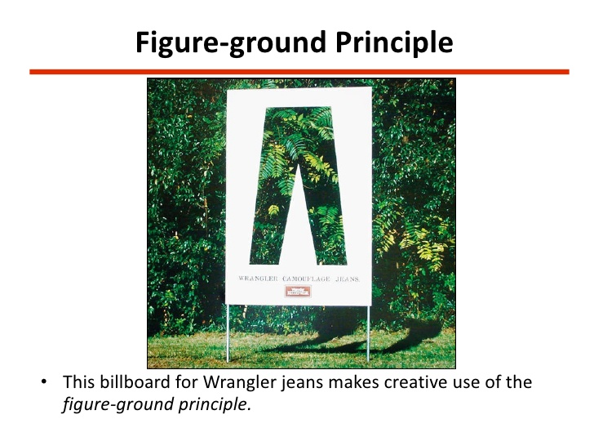
Real examples

Slide 4


Slide 5
Search as a fundamental process
Types of search:
  Feature search
  Conjunction search
  Motion detection based search
  Memory based search
Attention – Orienting and selection
  Endogenous (voluntary)and Exogenous (automatic)

Slide 6
Most of the time
Endogenous orientation
Selection varied (with a goal)
Without overt eye movement, still stimuli can be perceived in the periphery
We process information based on overt need, covert sensory stimulations, exogenous orientation, task goals.
Pre-attentive processes are across input signals but selective attention is the key process.

Slide 7
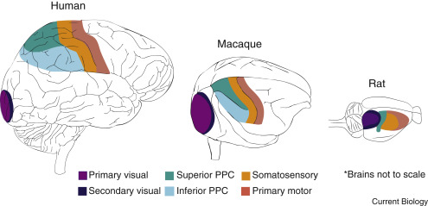
Recap of brain
Link

Slide 8
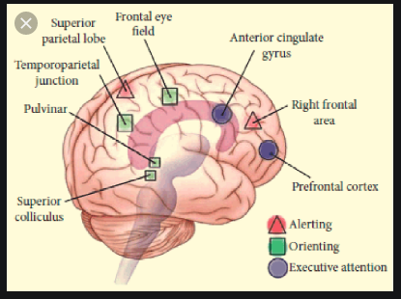
Default:
Alerting, Orienting, Executive control

Slide 9
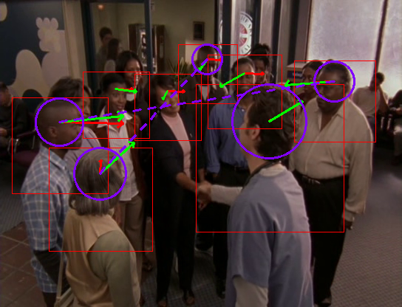
Attention

Slide 10
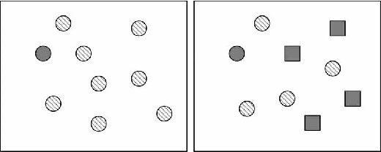
Feature vs conjunction search
Feature search
Conjunction search

Slide 11
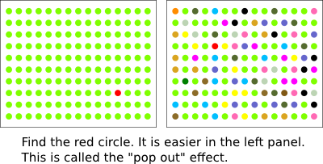
Feature Search examples

Slide 12
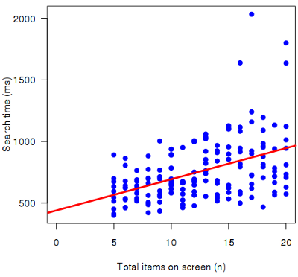
Feature search with distractors

Slide 13

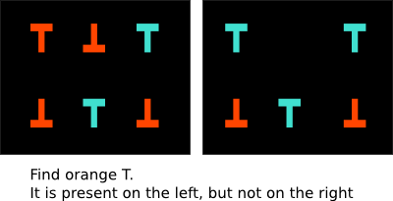
Conjunction search

Slide 14
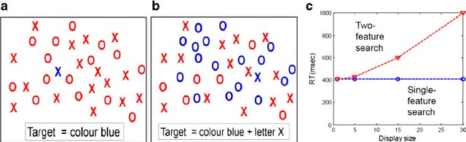
Typical result comparison

Slide 15

Real world search
Are there more males or females?
Looking for an old friend?

Slide 16

Real world search
Does it have the brand Y you are looking for?
Does it have many organic/green brands in this store?

Slide 17
Feature integration theory
Master map: Some properties coded rapidly, early (in parallel) across the visual field using pre-attentive processing [color, size, shape]
Feature map: A later process integrates other attributes/dimensions for the stimuli at hand [cross-dimensional processing]. Different properties of the object are encoded in specific feature maps.

Slide 18
Feature integration example 1
For feature search, single discriminative feature is enough to “pop out”

Slide 19
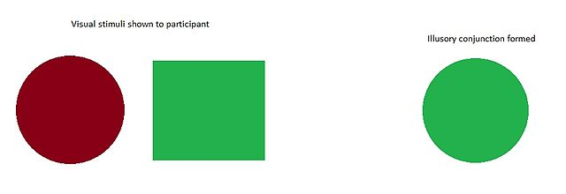
Feature Integration example 2

Slide 20
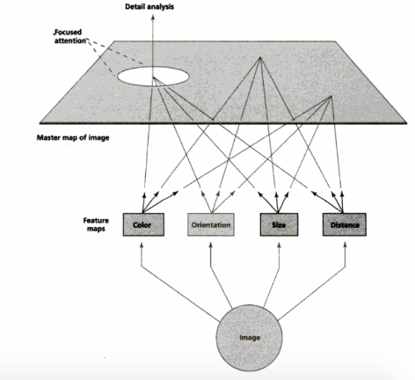

Slide 21
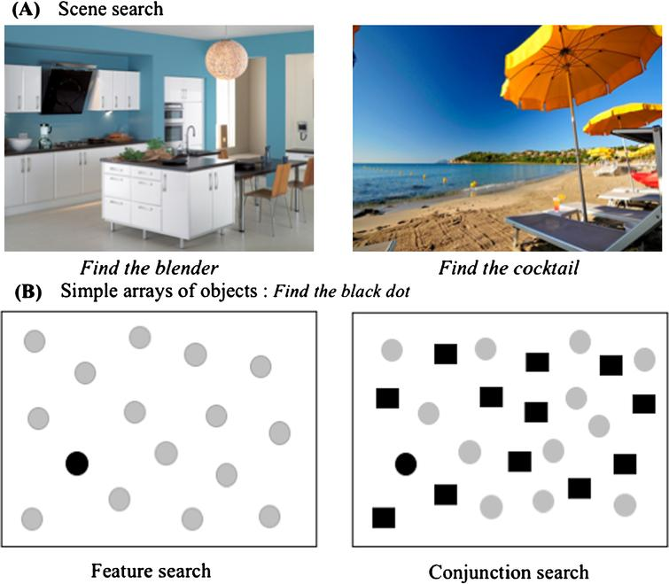

Slide 22
Guided search model
ACTIVATION MAP: Representation of visual space at locations that represent likelihood of the location containing a target.
Initial processing: Based on basic features, create an activation map of the stimulus
Every item has its own level of activation
Search for target based on peaks of activation
Efficient vs inefficient: If target generates highest or one of the highest peak activations.

Slide 23
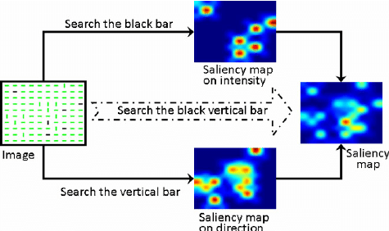
Conjunction search: computational

Slide 24
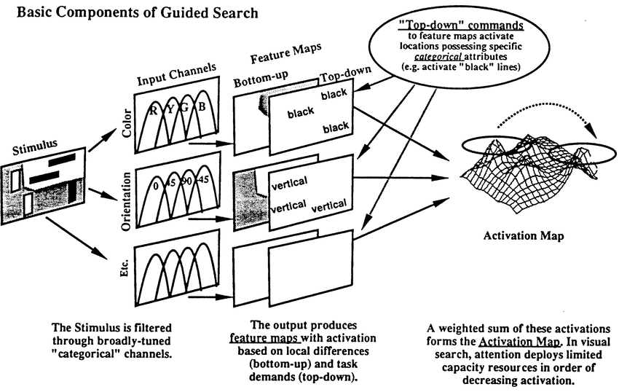

Slide 25
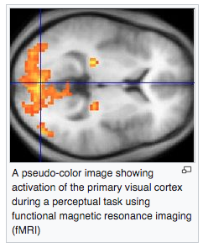
Biological basis

Slide 26
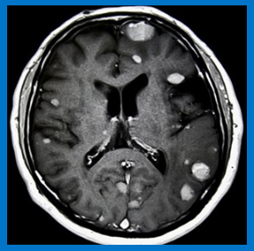
Real world search
Does this tumor look bad ?
Possibly [fatal] brain tumor or something else?

